Slide 1
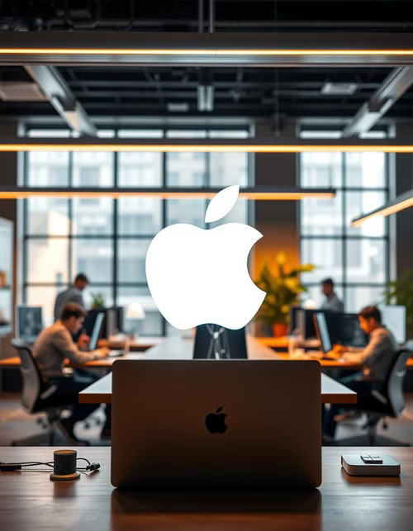
MacBook Portfolio Strategy 2025-2030
Driving Innovation, Sustainability, and Market Leadership
Group Name: Fearless Ferrets

Slide 2
Portfolio Overview & Business Need
Company Context:
Global leader in premium computing
Commitment to innovation & sustainability
Current market leadership position
Portfolio Impact :
Revenue growth potential: $500B market by 2030
Environmental leadership opportunity
Market expansion across segments
Business Need:
Maintain technological leadership
Achieve carbon neutrality by 2030
Expand global market presence
Drive AI integration in computing

Slide 3
Strategic Objectives & Benefits
01
Innovation Leadership
Expected Benefits:
Market Leadership Position
Environmental Stewardship
Revenue Growth & Profitability
Enhanced Customer Experience
25% patent growth by 2028
Sustainability
02
100% recycled materials by 2030
Market Growth
03
15% share increase by 2026
Customer Experience
04
NPS > 80

Slide 4

Portfolio Programs & Projects
Hardware Innovation Program:
M-Series Processor Development
Next-Gen Battery Technology
Thermal Management Innovation
Sustainability Program:
Recycled Materials Initiative
Carbon-Neutral Manufacturing
E-Waste Reduction Program
Energy Efficiency Standards
Market Expansion Program:
Affordable MacBook Variant
Educational Partnerships
Customer Experience and Loyalty Program:
AppleCare Plus Expansion
MacBook Concierge Service
AI/ML Integration Program:
Real-Time Object Detection
AI-Powered Performance Optimizer
Supply Chain Optimization Program:
Supplier Sustainability Assessment
Strategic Partnerships :
Renewable Energy Partnership
Collaborations with AI Startups

Slide 5

Governance & Stakeholder Management
link
Governance Structure:
- Portfolio Governance Board
- Program Management Office
- Seven Program Leads
- Implementation Teams
Key Stakeholders:
High Power/High Interest:
- Executive Leadership
- Program/Project Team
AI Partners
High Power/Medium Interest
- Technology Partners & Suppliers
Low Power/High Interest:
- Customers, External Consultants
High Power/Low Interest:
- Regulatory Bodies
Engagement Strategy:
- Monthly executive reviews
- Quarterly stakeholder updates
- Feedback Mechanisms

Slide 6
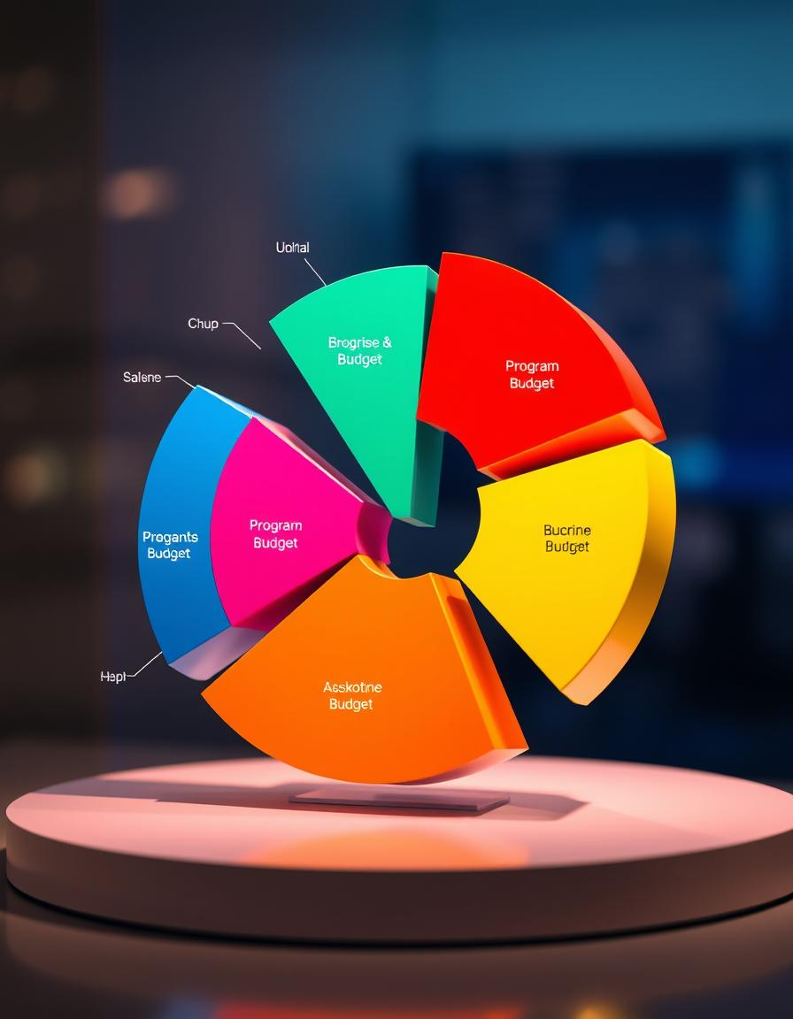
Investment Strategy & ROI
Total Portfolio Investment: $11.24B
Program Allocation:
- Hardware Innovation: 23.9% ($2.1B)
- Sustainability: 20.5% ($1.8B)
- Market Expansion: 10.2% ($900M)
- AI/ML Integration: 11.4% ($1.0B)
- Supply Chain: 9.1% ($800M)
- Customer Experience: 6.8% ($600M)
- Strategic Partnerships: 9.1% ($800M)
- Contingency: 20% ($2.24B)
Budget Allocation by Category:
- R&D and Engineering: $2.5B
- Equipment & Infra: $2.51B
- Implementation and Integration: $1.3B
- Product Development: $800M
- Training and Management: $500M
- Marketing and Launch: $380M

Slide 7
Timeline & Major Milestones
2025 (Launch Phase) | 2026-2027 (Implementation Phase) | 2028-2030 (Achievement Phase)
M-Series prototype, NexGen Battery development | Full production launch | 40% carbon reduction
Sustainability program initiation | Market expansion rollout | 100% recycled materials
Educational partnerships launch | Manufacturing transformation | Global market presence
AI features development | AI-Powered Performance Optimization | Complete ecosystem transformation
Affordable MacBook Variant | MacBook Concierge Service (beta)
Notes:
We begin in 2025, the launch phase, where we set the stage for Apple's transformation:
The M-Series Processor Development kicks off, with a prototype release planned for December 2025 and final production by December 2026. This project ensures we stay ahead in technological innovation.
Next-Gen Battery Technology begins, targeting a prototype by July 2025 and completion by November 2026, addressing energy efficiency and sustainability.
The Recycled Materials Initiative starts, aiming for 50% recycled material usage by June 2027.
The Affordable MacBook Variant begins development, with a model release planned for October 2026.
AI Features Development is initiated to integrate advanced capabilities like real-time object detection and AI-powered performance optimizations into our MacBooks.
"Additionally, we’ll launch Educational Partnerships, piloting programs by September 2025 to increase MacBook adoption in schools and universities, setting a solid base for market expansion."
2026-2027: Implementation Phase – Delivering Results
"In 2026-2027, we transition from planning to execution:
Full-scale production launches of new MacBook models and sustainability initiatives.
Completion of the AI Integration Program, bringing cutting-edge features to MacBooks by October 2026.
Thermal Management Optimization, with the final solution ready for production by October 2026, ensuring enhanced performance and user experience.
Launch of the MacBook Concierge Service, starting as a beta in November 2025 and fully operational by December 2026.
AI-Powered Performance Optimization, with a full rollout scheduled for December 2026, ensuring superior user experiences and optimized device functionality.
"These efforts culminate in the launch of affordable models and enhancements, positioning Apple for success across diverse customer segments."
2028-2030: Achievement Phase – Realizing the Vision
"Finally, between 2028 and 2030, we achieve the transformative goals of this portfolio:
Achieving a 40% reduction in carbon emissions by December 2028 through initiatives like Carbon-Neutral Manufacturing.
Scaling the Recycled Materials Initiative to reach 100% usage across all MacBook production by 2030.
Realizing a global market presence through strategic expansions and partnerships.
Delivering a completely transformed ecosystem with sustainable manufacturing, innovative technology, and an unmatched customer experience."
"This phase underscores Apple’s leadership in sustainability and innovation, leaving a lasting impact on the industry and the environment."

Slide 8
Risk & Quality Management
Risk Management
Quality Framework:
01
Supply Chain:
- Performance metrics (30% improvement)
- Sustainability standards
- Customer satisfaction goals (NPS >80)
- Vendor quality requirements
- Supplier diversification
- Real-time monitoring
- Buffer inventory
02
Technology:
- Talent Attrition, Technological Delays
- $2.5B R&D investment
- Strategic partnerships
03
Market & Competition:
- Regional strategies
- Educational partnerships
- Competitive monitoring
Notes:
1. Supply Chain Risks "Supply chain disruptions are a top concern, especially for a global portfolio like ours. We’ve identified three primary risks:
Material Shortages: Delays due to limited availability of sustainable and high-quality materials.
Supplier Dependency: Over-reliance on a small number of suppliers increases vulnerability.
Logistical Challenges: Transport delays or disruptions affecting product timelines.
Mitigation Actions:
Supplier Diversification: Expanding our network with five new sustainable material suppliers by 2026 to ensure consistent supply.
Real-Time Monitoring: Using advanced tracking systems for inventory and production status to preempt issues.
Buffer Inventory: Maintaining safety stock for critical components to handle sudden supply chain interruptions.
Partnership Agreements: Formalizing contracts with suppliers to prioritize Apple’s needs during high-demand periods."
2. Technology Risks "Innovation carries inherent risks, particularly in delivering cutting-edge products like the M-Series processors and AI-powered MacBook features. Identified risks include:
Technological Delays: Development challenges leading to project delays.
High R&D Costs: Unanticipated expenses during innovation phases.
Talent Attrition: Losing key technical talent affecting project progress."
Mitigation Actions:
$2.5B R&D Investment: Allocated specifically for advancing proprietary technologies and overcoming potential roadblocks.
Strategic Partnerships: Collaborating with AI startups and renewable energy companies to share risks and accelerate innovation.
Talent Retention Programs: Offering competitive benefits and career development opportunities to retain top talent.
Contingency Budget: A 20% reserve ensures readiness for unforeseen technological challenges."
3. Market and Competition Risks "Apple operates in a dynamic and highly competitive market where customer preferences and competitor actions can pose risks. Key risks include:
Market Shifts: Changing consumer demands or economic conditions affecting product adoption.
Pricing Risks: Pressure to maintain competitiveness in price-sensitive markets.
Competitor Actions: Innovations or strategies from competitors impacting Apple’s market position."
Mitigation Actions:
Regional Strategies: Tailoring products and marketing campaigns to meet local market needs.
Affordable MacBook Variant: Launching a cost-effective model by 2026 to cater to price-sensitive markets.
Educational Partnerships: Expanding collaborations with schools and universities to drive MacBook adoption in education.
Competitive Monitoring: Regular analysis of market trends and competitor activities to anticipate and respond effectively."
4. Environmental and Regulatory Risks "Given Apple’s commitment to sustainability, environmental and regulatory risks are critical. These include:
Regulatory Non-Compliance: Failing to meet environmental or safety regulations in key markets.
Carbon Reduction Challenges: Delays in achieving carbon neutrality goals.
Recycling Efficiency: Ineffective material recovery processes impacting sustainability targets."
Mitigation Actions:
Carbon-Neutral Manufacturing: Implementing renewable energy solutions by 2025 to meet regulatory and environmental standards.
Recycled Materials Initiative: Scaling up recycled content usage to 100% by 2030, supported by supplier certifications.
Third-Party Audits: Regular audits to ensure compliance with environmental standards.
E-Waste Reduction Programs: Expanding Apple’s Trade-In program to enhance material recovery and recycling efforts."
Quality Management Framework
"Apple’s commitment to excellence is upheld through a rigorous quality management framework. Here’s how we ensure every MacBook meets our standards:
Performance Metrics: Ensuring at least 30% performance improvement over previous generations, verified by independent testing.
Sustainability Standards: Aligning every product with Apple’s goal of 100% recycled materials by 2030 and exceeding global energy efficiency benchmarks.
Customer Satisfaction Goals: Targeting a Net Promoter Score (NPS) of over 70 to maintain exceptional customer loyalty.
Vendor Quality Requirements: Collaborating closely with suppliers to meet stringent quality and sustainability standards.
"Monthly reviews, supplier certifications, and third-party audits form the backbone of our quality assurance process, ensuring consistent excellence."

Slide 9
Success Criteria & Monitoring
01
Success Thresholds:
02
Monitoring Framework
03
Performance Levels:
- Innovation Metrics: 80% of targets
- Sustainability Goals: 90% achievement
- Market Growth: 85% of objectives
- Financial Returns: 100% of ROI targets
- Weekly Status Updates
- Monthly KPI dashboard
- Quarterly portfolio reviews
- Annual strategic assessment
- Quality Framework
>90%: Best practice analysis
80-90%: Continue monitoring
60-80%: Improvement plan
<60%: Immediate action
Notes:
Success Criteria
"Apple defines success through measurable targets across four critical dimensions:
Innovation Metrics: Achieving 80% of innovation-related goals, such as patent filings, hardware performance, and feature adoption, to maintain technological leadership.
Sustainability Goals: Delivering 90% of our environmental targets, including a 40% reduction in carbon emissions by 2028 and achieving 100% recycled materials in production by 2030.
Market Growth: Reaching 85% of market expansion objectives, including increased market share, particularly in education and emerging regions.
Financial Returns: Meeting 100% of ROI targets, ensuring the portfolio’s financial health and long-term sustainability."
From the paper: "For instance, Apple targets a 15% increase in MacBook market share by 2025 and an NPS above 80 to reflect customer satisfaction and loyalty."
Quality Management Framework
"At Apple, quality is non-negotiable. Our quality framework focuses on:
From the paper: "Apple uses a multi-tiered quality assurance process, including independent audits, monthly performance reviews, and supplier certifications, to ensure these standards are consistently met."
Product Excellence: Ensuring a minimum of 30% performance improvement in MacBooks compared to previous generations, validated through independent testing.
Sustainability Standards: Aligning with Apple’s global environmental goals, such as exceeding energy efficiency guidelines and adhering to circular economy principles.
Customer Satisfaction: Maintaining exceptional user experiences with customer satisfaction rates above 90% and a Net Promoter Score (NPS) exceeding 70.
Vendor Quality Assurance: Collaborating with suppliers to meet stringent quality standards for raw materials, components, and manufacturing processes."
Portfolio Monitoring Framework
"To ensure ongoing alignment with success criteria, we have a robust monitoring system:
Weekly Status Updates: Real-time updates from program leads to track milestones and address issues proactively.
Monthly KPI Dashboards: Comprehensive dashboards highlight key performance indicators across all portfolio areas.
Quarterly Portfolio Reviews: A deep dive into the portfolio’s performance to assess progress, identify risks, and adjust strategies.
Annual Strategic Assessments: A high-level evaluation of the portfolio’s alignment with Apple’s long-term objectives."
From the paper: "This framework is further supported by third-party validations and stakeholder feedback loops to ensure objectivity and transparency."
Quality Management Process
"Our quality management process follows a structured lifecycle:
Planning: Quality standards and performance benchmarks are established during the project initiation phase.
Execution: Regular quality checks are integrated into the project lifecycle to ensure compliance at every stage.
Validation: Independent testing and third-party audits confirm that all products meet Apple’s high standards.
Continuous Improvement: Feedback loops from customers, suppliers, and stakeholders help refine processes and address gaps promptly."
From the paper: "Apple also uses a performance monitoring framework with defined thresholds:
Performance exceeding 110% triggers best practice analyses.
90-110% performance warrants regular monitoring.
80-90% requires an improvement plan, while performance below 80% demands immediate corrective action."
5. Integration with Success Criteria
"Our performance and quality management systems are tightly integrated with Apple’s strategic goals:
Innovation: The M-Series chip development, for instance, is expected to deliver a 30% performance improvement over the previous generation, validated through GeekBench and Metal benchmarks.
Sustainability: Carbon reduction metrics are tracked monthly, with third-party certifications verifying progress toward a 40% reduction by 2028.
Customer Experience: Achieving high NPS and customer satisfaction scores through continuous feedback and feature enhancements.
Financial Performance: Ensuring all projects exceed the ROI threshold of 15%, with an average IRR of 22% across the portfolio."

Slide 10
Next Steps & Approval Request
Seeking Approval For:
Immediate Actions upon approval:
1. Portfolio Launch (January 2025)
2. PMO Establishment
3. Resource Allocation
4. First Wave Project Initiation
1. $11.24B Budget Allocation
2. Program Office Implementation
3. Initial Project Phase Launch
Portfolio Design Document
Thank You. Do you have any questions?
Email us at mkulkarni7993@sdsu.edu

